Slide 1
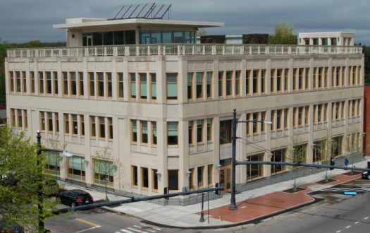
Nurse Practitioner Residency Training Program:
Training to Complexity; Training to a Model, Training for the Future
National Workforce Meeting
Denver, CO

Slide 2
Presented By:
Amy Barton, PhD, RN, FAAN
Associate Dean & Professor
University of Colorado
On behalf of…
Margaret Flinter, APRN, PhD, c-FNP, FAAN, FAANP
Senior Vice President and Clinical Director
Community Health Center, Inc.

Slide 3
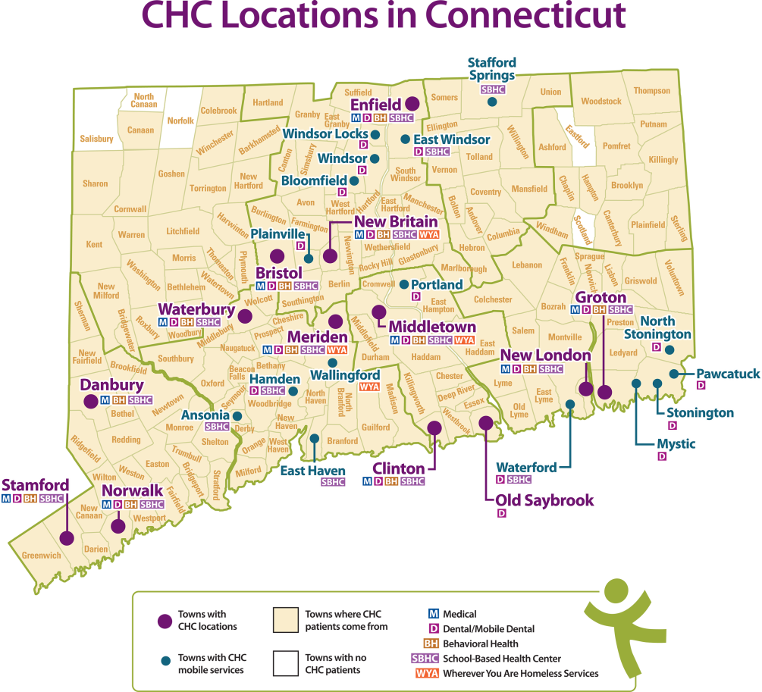
Community Health Center, Inc.
Federally Qualified Health Centers (FQHCs)
Nation’s largest safety net setting
Located in designated high need communities
Caring for more than 20 million patients
93% those served below 200% poverty and 35% uninsured
Employs more than 5,100 NPs – 24% of all medical visits
CHC Inc. Profile:
Founding Year - 1972
Primary Care Hubs – 13 ; 218 sites
Organization Staff – 650; active patients; 130k
Specialties: psychiatry, podiatry, chiropractic
Specialty access by e-Consult
Elements of Model
Fully Integrated teams
Fully integrated EMR
PCMH Level 3
SBHC and WYA programs
INNOVATIONS
Postgraduate Training Programs
Weitzman Institute
Project ECHO –CT and e-Consults
Foundational Pillars
Clinical Excellence
Research & Development
Training the Next Generation

Slide 4
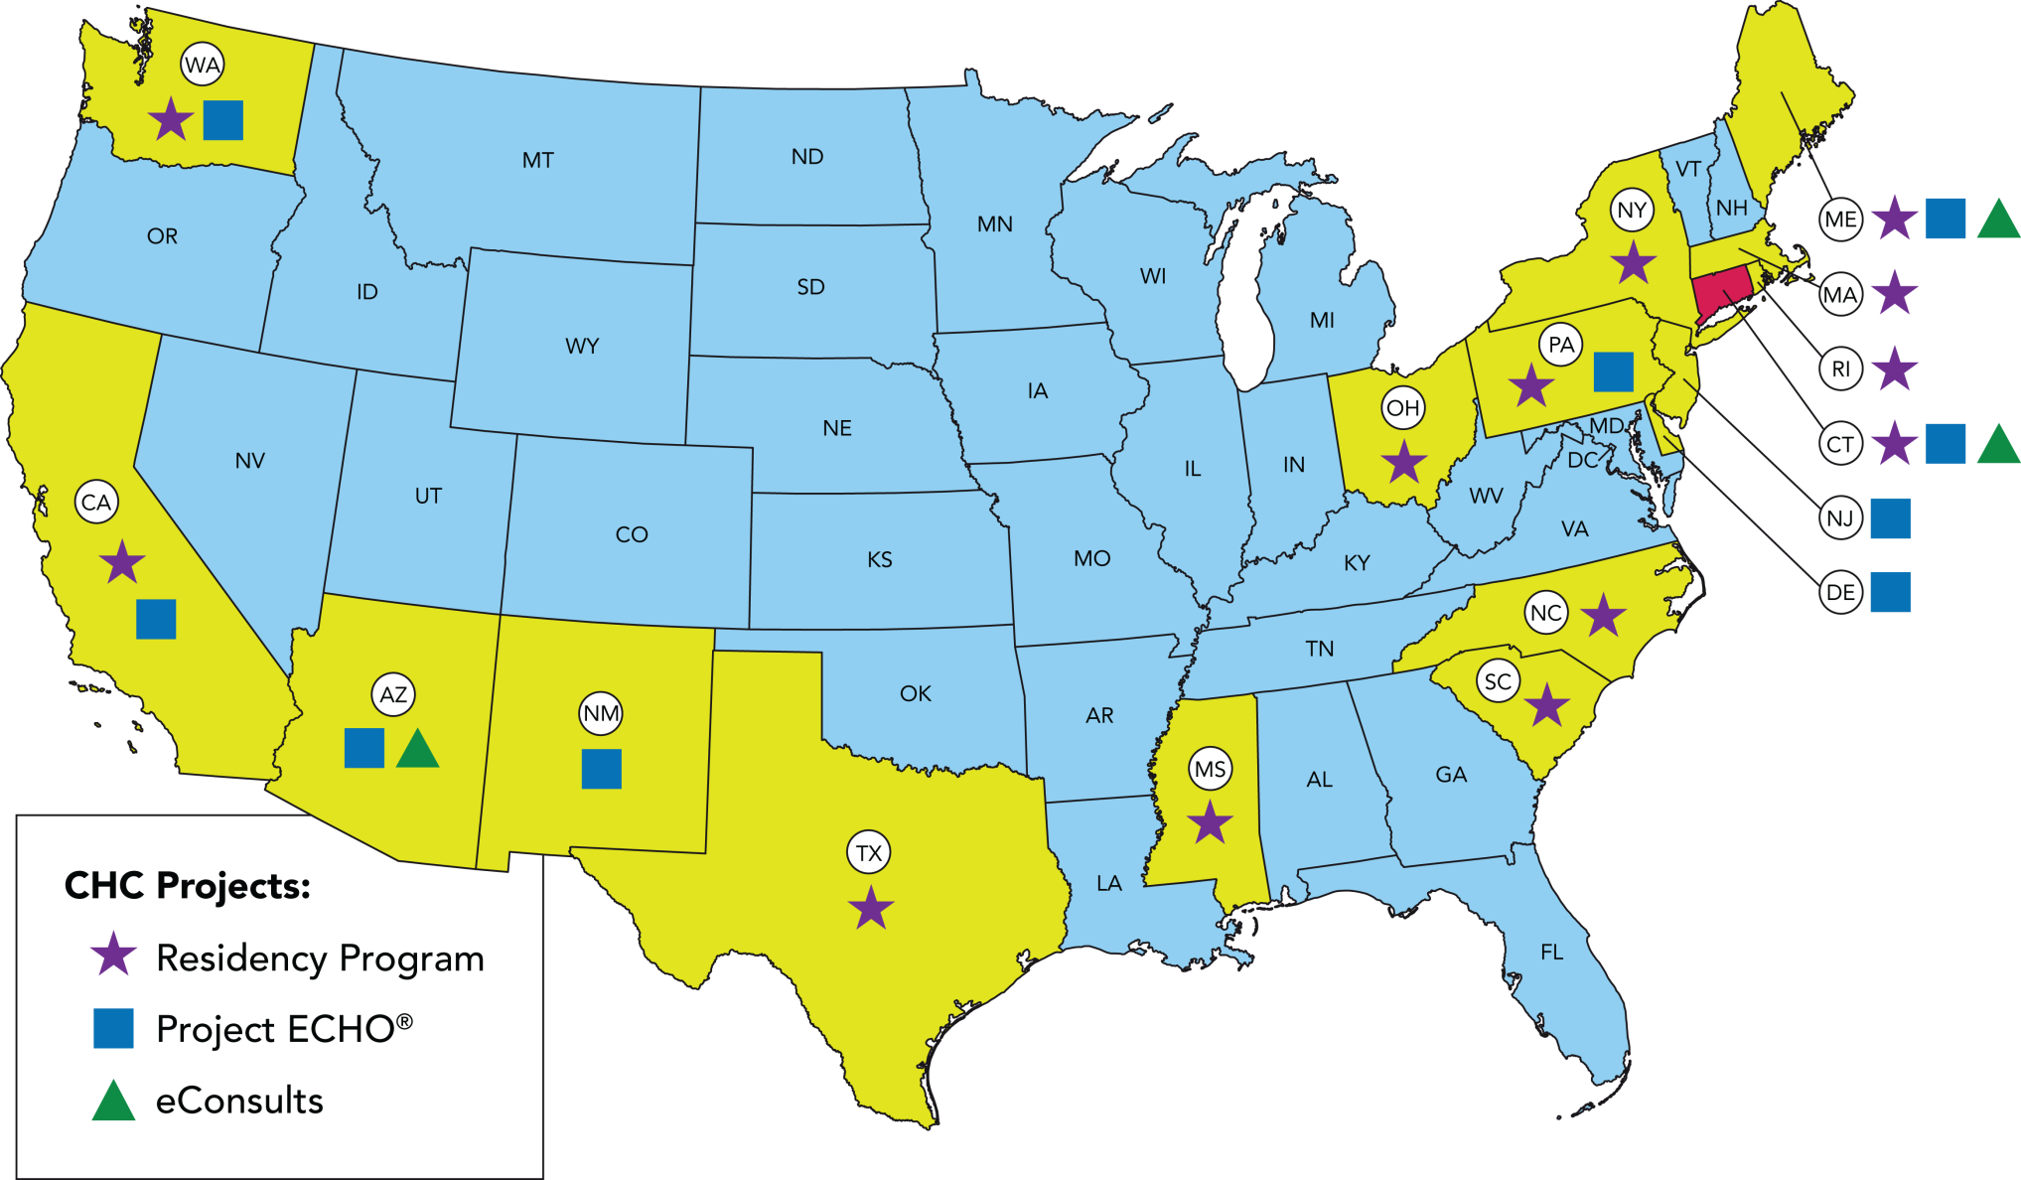
CHC’s Educational, Technical & Innovation Projects

Slide 5
Why a Residency/Fellowship?
New NP graduates are not always sufficiently prepared to serve as fully independent primary care providers, especially in high acuity areas like Federally Qualified Health Centers.
A structured post-graduate residency training program, improves the clinical skills, confidence, productivity & job satisfaction needed to work successfully in the underserved setting.
Residencies are a growing trend in NP professionalism

Slide 6
CHC’s Drivers in Creating NP Residency Training
FQHCs and our patients need expert primary care providers prepared to manage social and clinical complexity in the primary care setting
Literature supports perceived desire for post-graduate residency training
Majority of NPs choose primary care, but are deterred from FQHC setting by mismatch between preparation, patient complexity, and available support
We can provide new nurse practitioners with a depth, breadth, volume, and intensity of clinical training and training to a model of care that primes them for FQHC success
Train new nurse practitioners to a model of primary care consistent with the IOM principles of health care and the needs of vulnerable populations
Create a nationally replicable model of FQHC-based Residency training for NPs
Prepare new NPs for practice in any setting—rural, urban, large or small
Develop a sustainable funding methodology

Slide 7
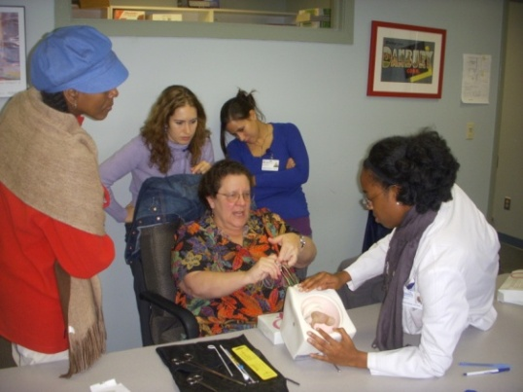
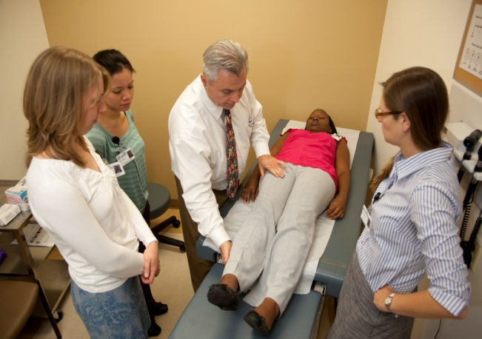
Launch and Growth
First steps: published a concept paper in 2005 on the need for residency training for new NPs in FQHCs; talked with national leaders in NP community, primary care, community health centers, and Congress along with many of my role models, mentors, and heroes/heroines
Recruited the initial NP Residency cohort of 4 NPs; Rep. Sayers (d) of CT introduced legislation commending the model in CT
Held a Capitol Hill briefing in August, 2008, attended by congressional aides, staffers, policy wonks, fellows—including Fellow to Senator Inouye—which led ultimately to the writing of Section 5316 of the ACA

Slide 8
Replication and Challenges
2ND NP Residency launched at UMASS Worcester in 2009; other early programs followed at VA-CT (2009), a Nurse Managed Health Center (Glide) in San Francisco, and community health centers in Texas, Washington, Maine, and beyond
CHC, Inc. expanded from four to eight and then 10 residents per year—by 2012, receiving close to 150 applications per year from all over the country. The VA System expanded programs to five centers of excellence , and large health systems such as Carolinas added primary care residencies
The anticipated funding under the ACA never materialized when Congress changed majority parties., and anticipated support for the concept of postgraduate NP Residency from the national NP organizations was not forthcoming

Slide 9
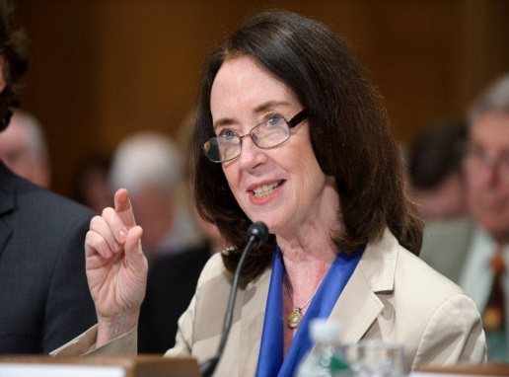
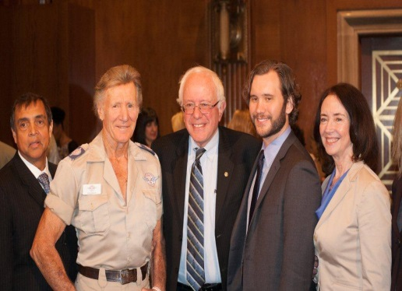
Legislative Actions
Seeking reauthorization and funding of Sec. 5316 of the Affordable Care Act
S. 2229, a bill titled the “Expanding Primary Care Access and Workforce Act,” now pending before the U.S. Senate as introduced by Senator Sanders on April 9, 2014, which would reauthorize and provide $75 million for the NPRTP through 2019.
Significant support from state of Washington community health centers, and the office of Senator Murray
Continued focus on working with HRSA workforce programs and NACHC on moving towards expansion of Teaching Health Center (THC) legislation
IOM Future of Nursing Report (2010) called for residency training of new advanced practice registered nurses; IOM report on GME (2014) calls for establishment of a “transformation fund” and consideration of GME funding for other providers.
None of these are likely to happen soon.
Medicaid GME remains a real and untapped potential source of support

Slide 10
What Does Primary Care Look Like in a FQHC?

Slide 11
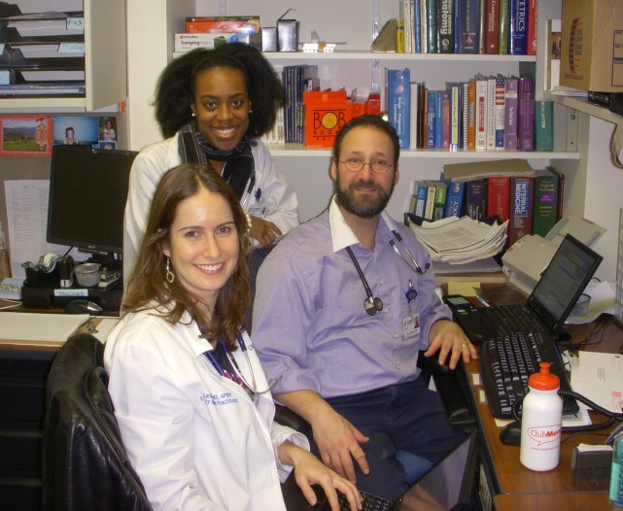
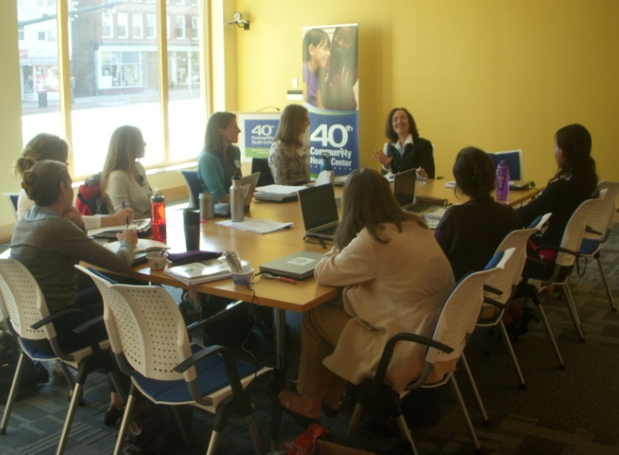
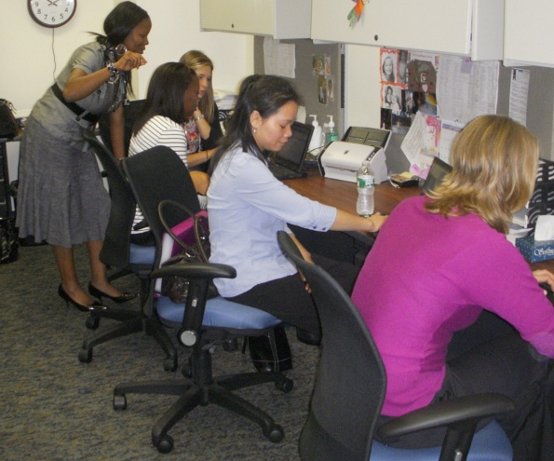
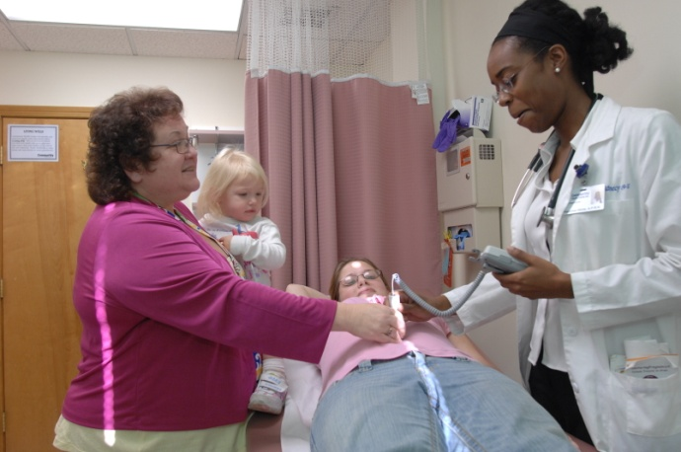
Elements of NP Residency Training

Slide 12
CHCI NP Residency
12 months, full time employment at CHC, Inc. Full integration into all aspects of the organization Training to clinical complexity and a high performance model of care
Precepted Continuity Clinics (4 sessions/week); residents develop and manage a panel of new patients with the exclusive attention of an expert preceptor NP, physician, or PA Specialty Rotations (2 sessions/wk x 1 month); orthopedics, dermatology, women’s health/prenatal care, adult/ child psychiatry, geriatrics, pediatrics, HIV care, Hep C care, newborn nursery, HCH Independent Mentored Clinics (3 sessions/week); Focused on diversity of chief complaints, efficiency, episodic and acute care. Didactic Sessions (1 session/week/ 50 per year: high volume/ complexity/risk/burden topics Continuous training to model of high performance health system: access, continuity, planned care, team-based, prevention focused, use of data and technology to drive clinical decision making and quality Ongoing multi-input evaluation component using qualitative and quantitative measures Training on the CHCI quality improvement model, including clinical microsystems and facilitation, as well as leadership development

Slide 13
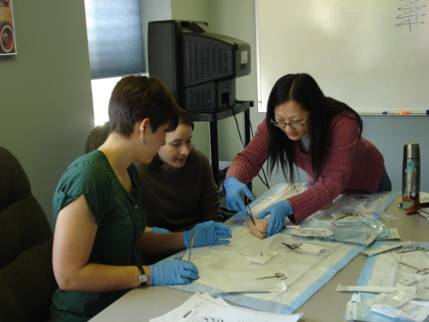
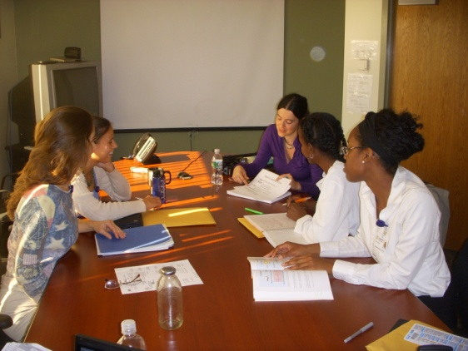
2014-2015 Didactics Sessions (partial listing)
Vaccines and Immunizations of Children and Adults
EKG Interpretation
Lab Values Interpretation in clinical context
Managing Diabetes; initiating insulin
Pain Management: pharmacologic and non-pharmacologic approaches
Managing Anxiety , Depression, ADHD in primary care
Self Management Goal Setting
Orthopedics, upper and lower extremities and back
Procedures: contraceptive, diagnostic, treatment
Addictions: ETOH, Tobacco, Drugs and their treatment
Mindfulness Based Meditation and Stress Reduction
HIV/AIDS- treatment and medications
Managing Hepatitis C in primary care
Chronic Liver, Kidney and Heart Failure

Slide 14
Structured Program Schedule

Slide 15
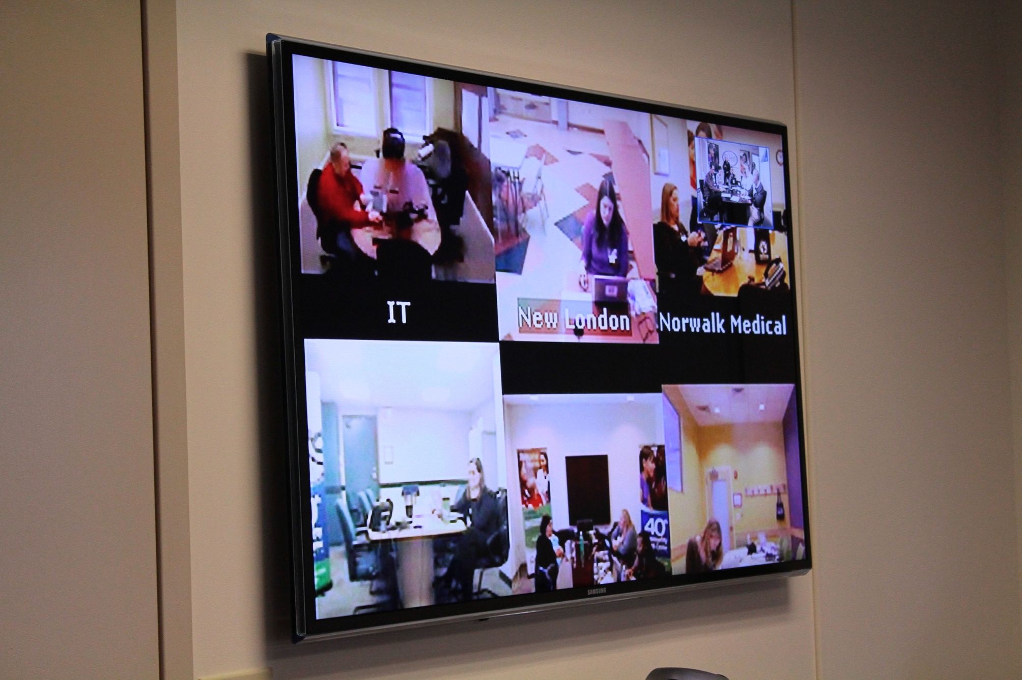
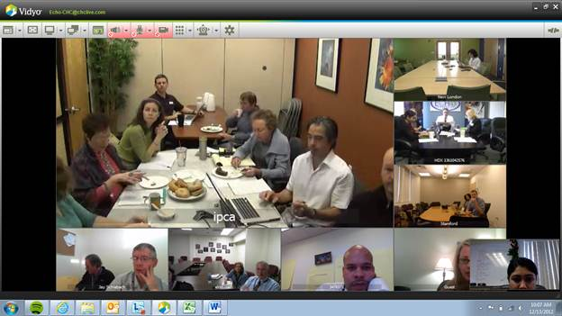
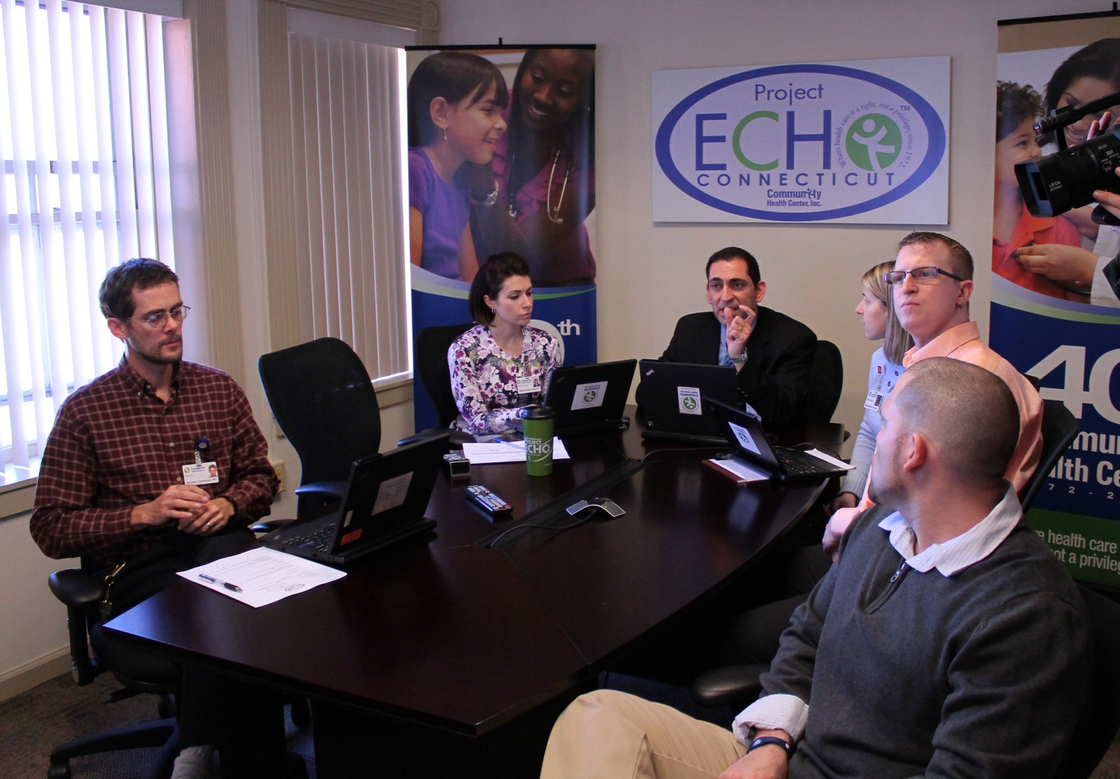
Participation in Project ECHO- CT
Weekly, case-based, distance learning with a team of experts in the care and management of patients with HIV, Hepatitis C, chronic pain, and buprenorphine.

Slide 16
What are the outcomes of NP Residency?
Real-time , on-going qualitative evaluation via weekly reflective journals show a predictable, progressive movement towards mastery, confidence, competence, and a sense of well being; consistent with Meleis’ transition theory.
Positive change over time of self-assessment of competency based on HRSA entry level competencies for new NPs; consistent with preceptor evaluations
Post- residency career and practice choices: do new NPs who complete a post graduate residency program continue to practice as primary care providers—and remain in safety net settings? Are they satisfied with that care?

Slide 17
Outcome Data
Each NP Resident develops a panel of approximately 500 patients and delivers approximately 900 visits
Peer review, frequent performance appraisals, and monthly precepted session with clinical advisor to document on-going progress
Weekly reflective journals provide insights into the nature of practice, of learning, and of the transition process
Research study using Meleis’ transition theory confirms successful completion of transition: mastery, a sense of confidence, and personal well being
More data from more residency training programs needed!
Program Year | Competency self-assessment- beginning of year | Competency self-assessment- end of year
2007-2008 | 3.4 (3.6) | 4.4 (4.5)
2008-2009 | 3.5 (3.25) | 4.0 (4.0)
2009-2010 | 3 .5 (3.4) | 4 .25 (4.3)
2010-2011 | 3.1 (3.0) | 4.56 (4.3)
2011-2012 | 3.6 (4.0) | 4.07 (4.0)
2012-2013 | 3.0 (3.4) | 4.2 (4.3)
2013-2014 | 3.6 (3.4) | 4.0 (4.46)
2014-2015 | 3.6 (4.0)

Slide 18
MyEvaluations.com

Slide 19
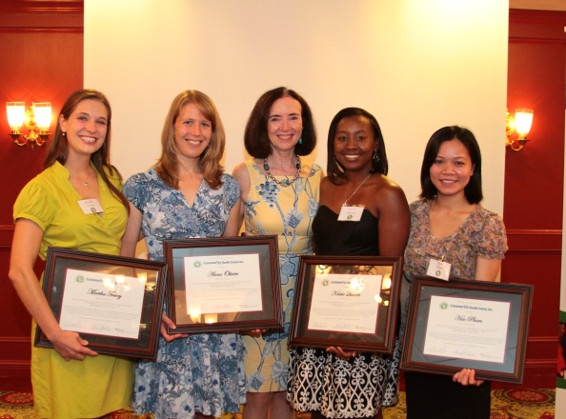
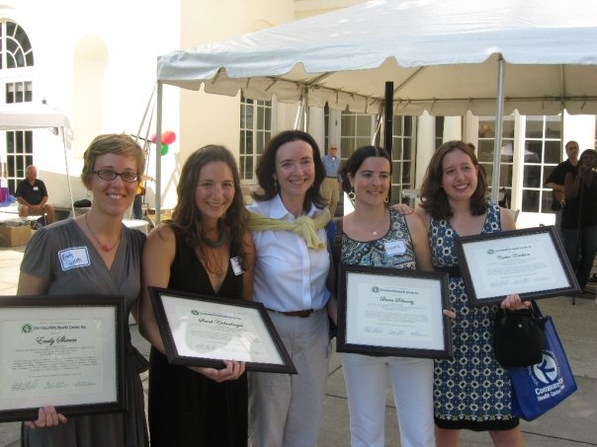
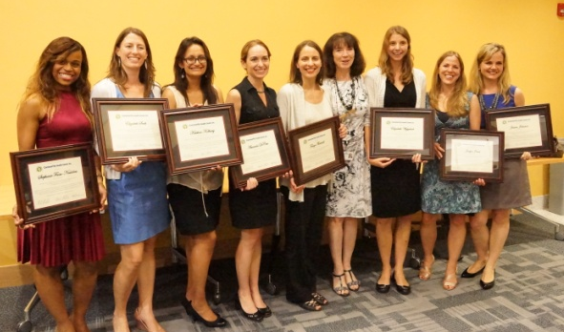
CHCI Residency Program Today
CHC has graduated 36 FNPs. 0 % drop-out rate.
Nationally, about 150 NPs have completed post grad primary care residencies. VA System has become strong partner.
Two programs (FQHC and NMHC) ended when funding ended.
CHC developed model of “remote hosting” of NP Residency programs with shared didactics, learning sessions, and orientation.
CHC and VA are Implementing a Psychiatric APRN Residency
Continuing aggressive efforts to secure legislative support for national funding of NP Residency
Added staff to focus on consortium and growth

Slide 20
Replicability and Spread
Our goal is national replication of CHC’s model of residency training for primary care nurse practitioners, particularly in the nation’s safety net.
CHC, Inc. will continue to support organizations interested in implementing NP residency programs, from sharing existing material, to formal consulting, to full remote hosting of NP Residency Programs
Currently there are 23 Primary Care Nurse Practitioner Residency programs across the country with 12 or more programs planning to launch in 2015
Current NP residency programs exist in FQHCs, NMHCs, Health Centers, major hospital and health systems, and the Veterans Administration System.
Fellowships have also developed in both primary care , specialty care, and acute/hospitalist NP areas, particularly in large health systems with significant numbers of advanced practice clinicians.

Slide 21
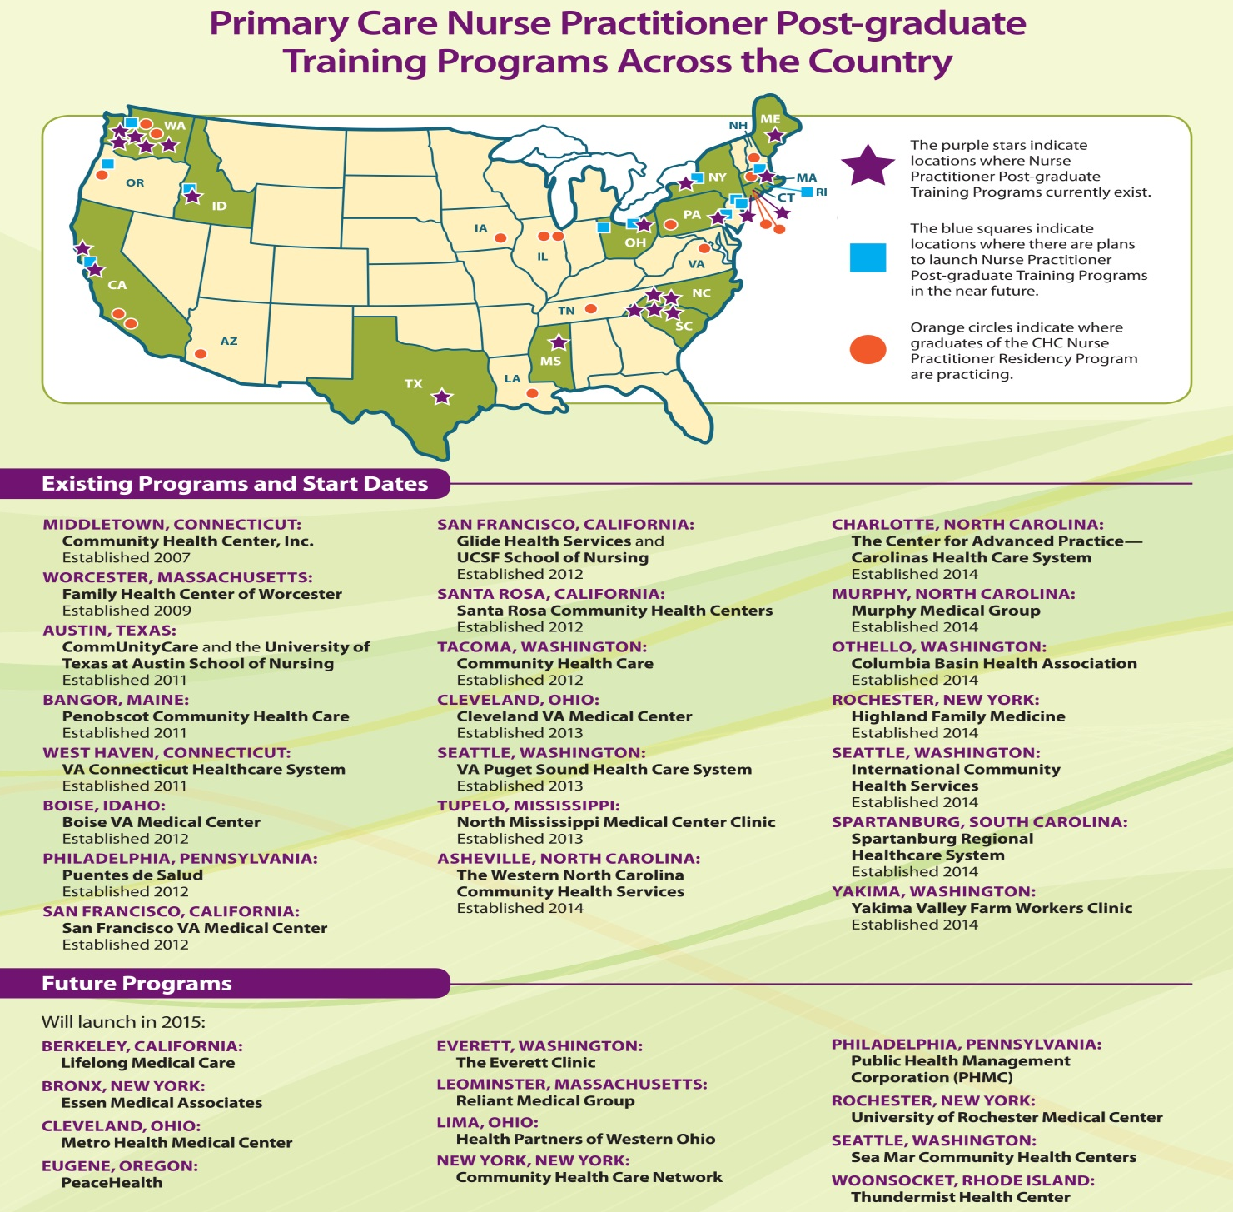

Slide 22
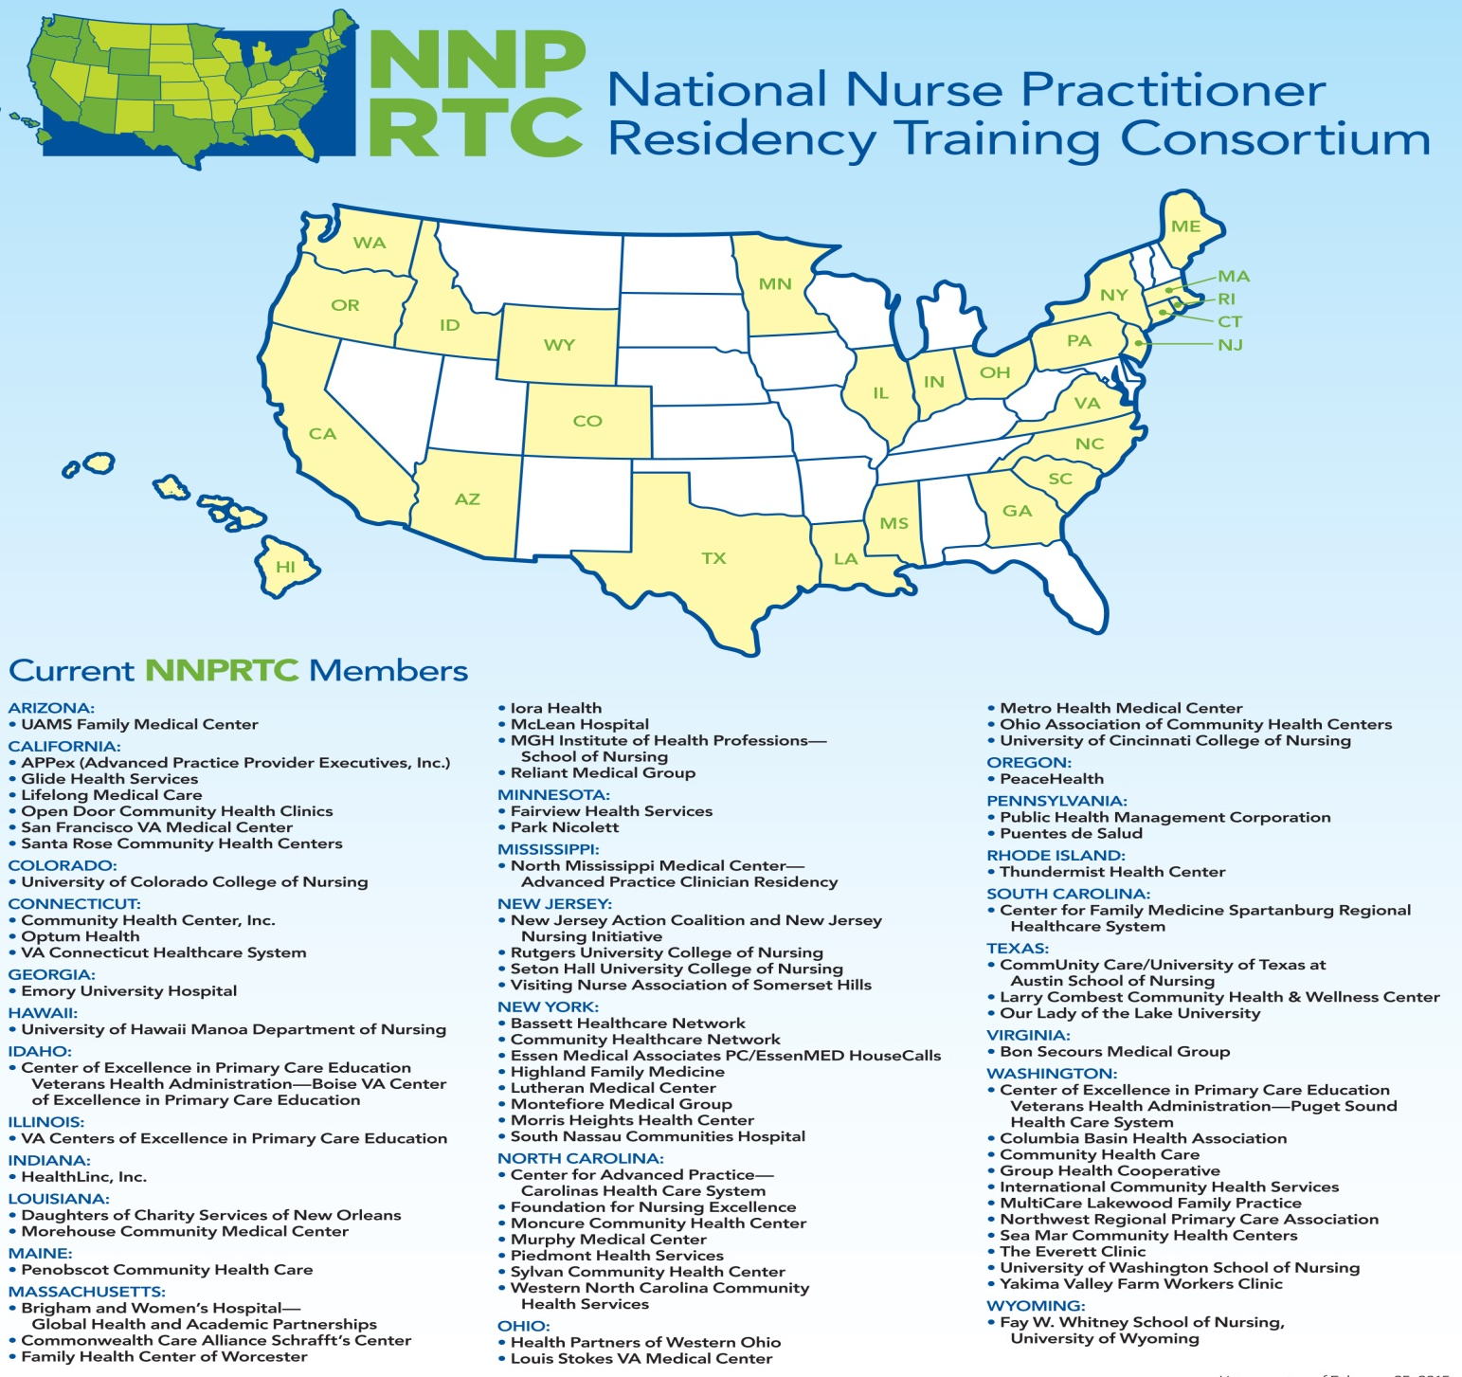
April 2,2015

Slide 23
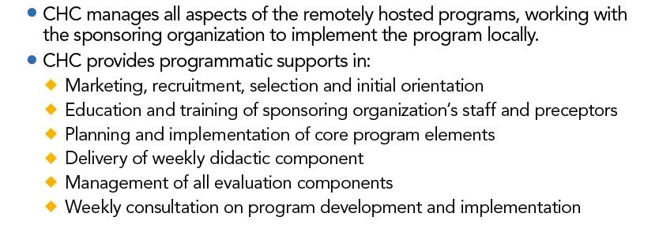
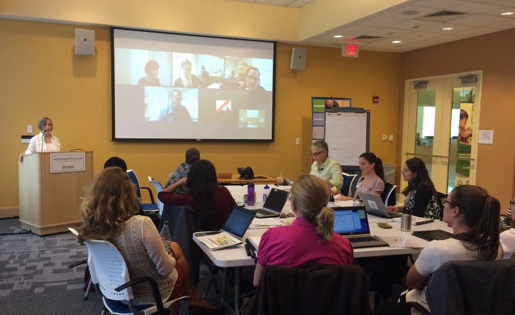
Remote Hosting NP Residency Programs

Slide 24
Accreditation
Why? To ensure high standards, supports model replication, and be prepared for future sustainable funding stream.
American Nurses Credentialing Center (ANCC) issued accreditation standards for “Transition to Practice” programs for newly certified advanced practice nurses in 2014.
National NP Residency Training Consortium (NNPRTC) has identified accreditation of programs as a priority area.
NNPRTC convened a national work group to develop standards (October-March 2015) and will be reviewed by members of the NNPRTC.
Consortium moving to 501(c)(3) status to continue its efforts to educate, advocate, legislate and accredit programs.

Slide 25
Accreditation Standards and Curriculum
Standards
Program Eligibility
Administration
Operations
Staff
Curriculum
Evaluation
Trainee Services
Curriculum Competency Domains
Patient-centered care
Knowledge for practice
Practice-based learning and improvement
Interpersonal and communication skills
Professionalism
System-based practice
Interprofessional collaboration
Personal and professional development

Slide 26
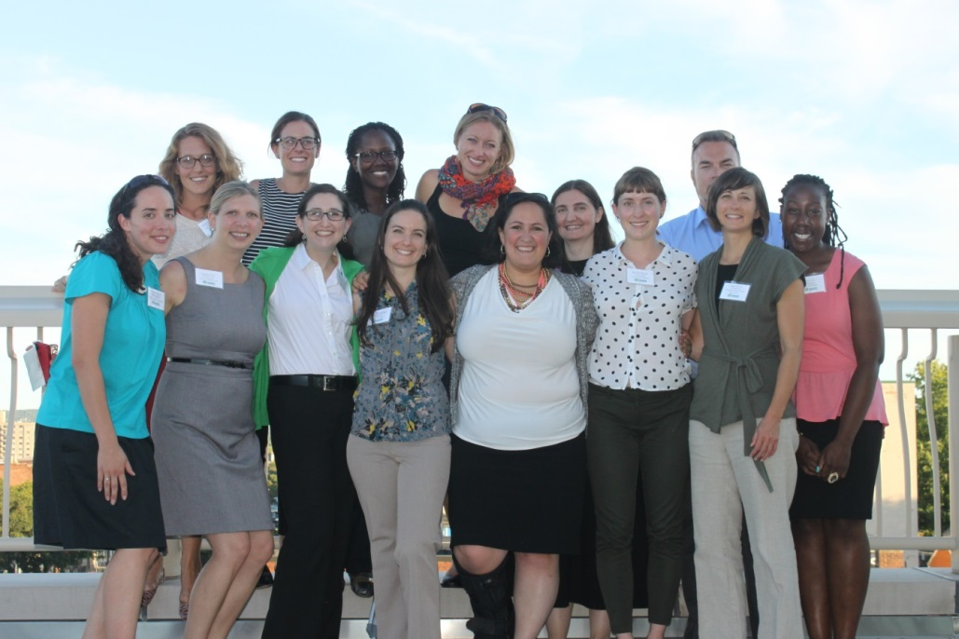
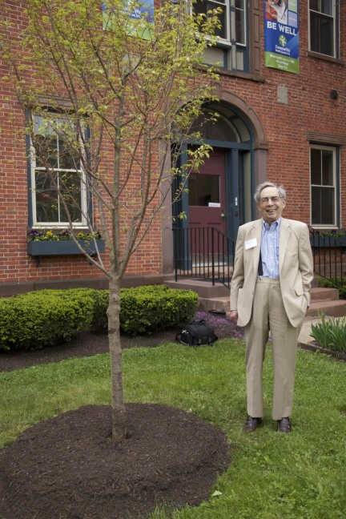
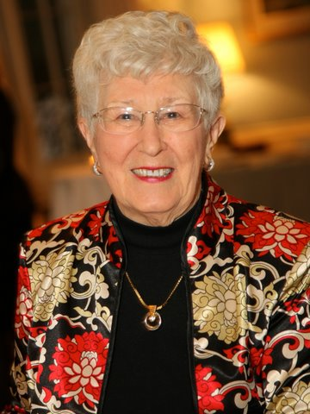
CHC’s 2014-2015
NP Residency Class,
Founders of the Future!
Dr. Jack Geiger
Founder,
U.S. Community
Health Center movement
Dr. Loretta Ford
Founder,
Nurse Practitioner
Movement

Slide 27
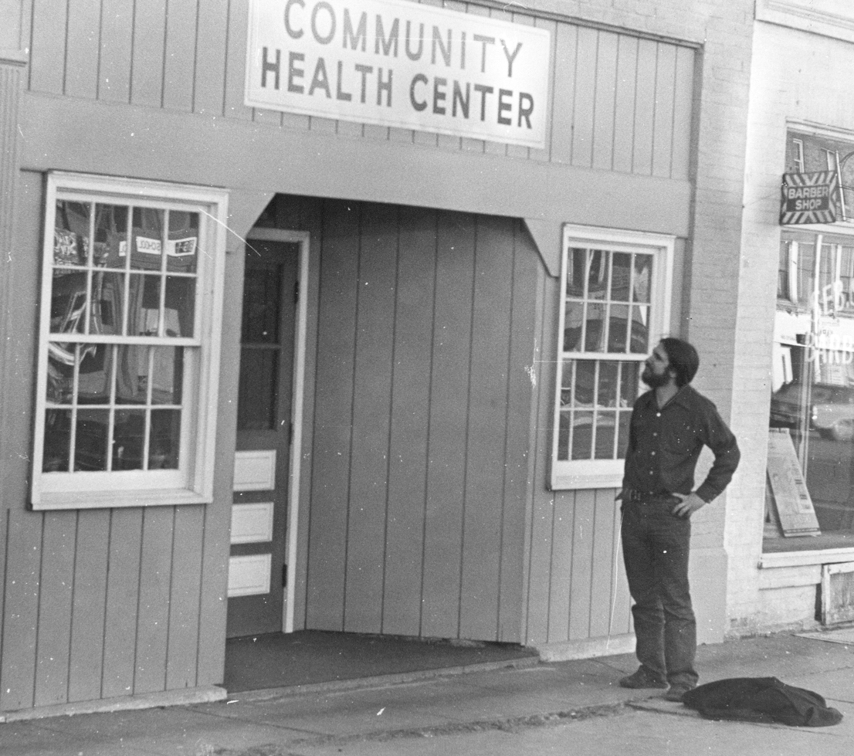
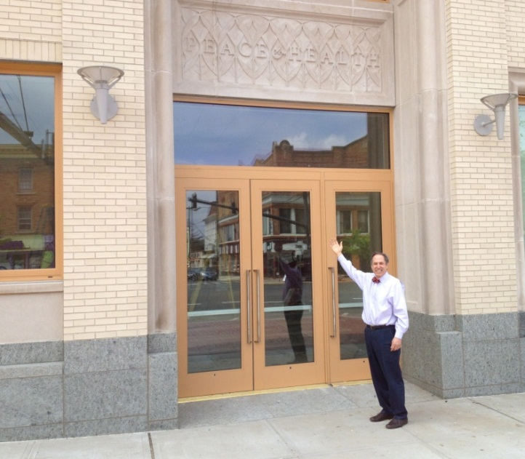
If you want to do something, do it. Just get started.

Slide 28
Margaret Flinter, APRN, PhD, c-FNP, FAAN, FAANP Senior VP and Clinical Director Email: margaret@chc1.com Tel: 860-852-0899 Kerry Bamrick Sr. Program Manager, Weitzman Institute Email: kerry@chc1.com Tel: 860-852-0834 Charise Corsino Program Manager, NP residency Training Program Email: charise@chc1.com Tel: 860-852-0853 Website: www.npresidency.com

