Slide 1
Putting it all Together: What Have we Learned About the Future Supply and Demand for Nurses and How Can we Address our Knowledge Gaps?”
Edward Salsberg GW School of Nursing and GW Health Workforce Institute
The Annual Forum of State Nursing Workforce Centers
Denver Colorado,
June 11, 2015

Slide 2
Overview
Why I worry about a potential surplus
What we learned from presentations at this meeting
Where that leaves us
Information and data needed to assess, track and project adequacy of supply to meet needs

Slide 3
Presentations on Supply, Demand & Projections
Auerbach: Will the RN Workforce Weather the Retirement of the Boomers?
Spetz: Demand for Newly-Graduated Nurses: Will the Labor Market Recover?
McMenamin: Two “Aging” Phenomena Create Uncertainty for RNs/APRNs, 2020 – 2045
Zangaro, Moore and Armstrong: Understanding & Using HRSA’s New Nursing Supply & Demand Model

Slide 4
Why do we care?
Problems with a shortage
Access
Quality
Costs
But great for new grads
Problems with a surplus
Unemployed nurses
New nurses with debt but no job
Enrollment drops/squeeze for schools
Wages stagnate

Slide 5
Factors Driving Supply
Entrants: Enrollment up sharply
Attrition
Growing older cohort but retirements delayed
Many non-patient care options for nurses

Slide 6
Why I Worry about a Possible Surplus
A history of fluctuations
Sharp growth in RN education pipeline
Major national push for delivery system redesign and constraint in growth of expenditures

Slide 7
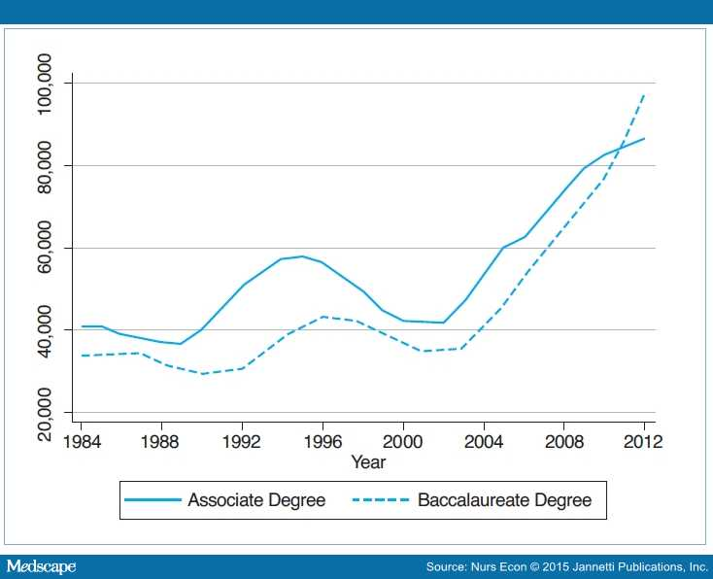
A History of Fluctuations
Number of nursing degrees awarded, by type
Buerhaus, PI, Staiger DO, and David Auerbach, “The Rapid Growth of Graduates from Associate, Baccalaureate and
Graduate Programs in Nursing,” Nursing Economics, 2015

Slide 8
Total 1st Time Takers and Passers – US Grads 2001-14

Slide 9
BSN 1st Time Takers and Passers, 2001-2014

Slide 10
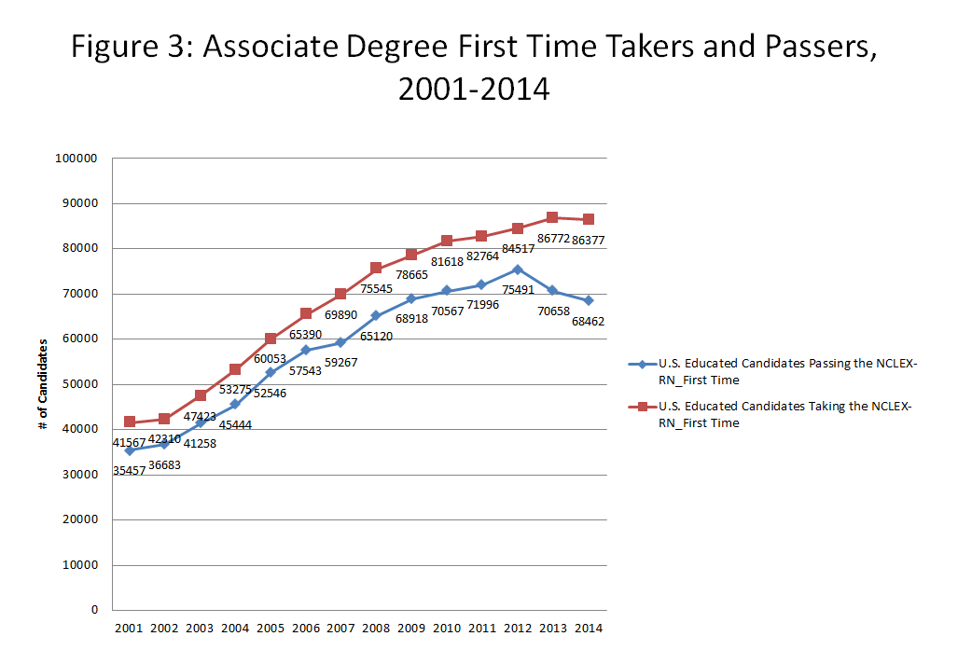

Slide 11
Diploma Graduates – 1st Time Takers and Passers, 2001-14

Slide 12
International Grads - 1st Time Takers & Passers, 2001-14

Slide 13
Growth in Nurse Practitioner Graduates* ²⁰⁰¹ ⁻ ²⁰¹⁴
Growth from 2013 to 2014 : 15.3%
Graduates
* Counts include master’s and post-master’s NP and NP/CNS graduates, and Baccalaureate-to-DNP graduates.
Source: American Association of Colleges of Nursing (AACN) and National Organization of Nurse Practitioner Faculties (NONPF) Annual Surveys

Slide 14
Federal Initiatives Support Systems Redesign

Slide 15
Neither Supply Nor Demand is Static
Typical Workforce Projection
Demand
Supply
Year
Notes:
Original projections
Shortage appears at once

Slide 16
Adaptations Occur
More Realistic Health Workforce Projections: Adjustments over Time (±5%?)
Demand
Supply
Year
Notes:
Adjust to meet short-term changes
Supply: hours, productivity (NPCs, tech)
Demand: Barrier-induced (cost, perceived availability)

Slide 17
So what did we learn from the presentations at this conference?

Slide 18
From David Auerbach: Attrition from test-takers
- Never pass test
+ Internationally-educated RNs
- Never become licensed
- Work part time (~20%)
- Never work in nursing (~10%)
Domestic NCLEX test-takers
FTE RNs

Slide 19
Observed Workforce: 2007-2013
850,000
580,000
370,000
Actual net increase
270,000
Expected net increase
Test-takers
Retirements

Slide 20
From Joanne Spetz
Surveys of employers and new graduates can provide valuable information on demand and marketplace for nurses
While indications of shortages in 2009 – 10, employers are adding jobs, especially hospitals and ambulatory care; and new grads faring better in job market over past few years
Reasons for expected increase in hiring: increasing census and increasing acuity
Variation in demand for experienced RNs compared to new RNs
Shortages in specific settings/skill sets, i.e operating room

Slide 21
From Peter McMenamin
The aging of the nurse workforce
The expanding need for care coordinators and the potential for nurses to provide this care
Hospital use has been slowly decreasing
But the baby boom generation is leading to sharp increase in number of elderly with extensive needs including for chronic care
Need to go beyond numbers and consider needed skill sets for an aging population, including for geriatric care, chronic care and end of life care

Slide 22
From George Zangaro, Jean Moore and David Armstrong
The new and improved nursing projection models
The web-based capability to use state data and scenarios
The importance of looking at supply and demand at the national, state and local levels
The national supply appears adequate through 2025 but many state and local shortage areas

Slide 23
The Complexity of Assessing Adequacy of Supply to Meet Needs
The national number may be sufficient but we can still have shortages by:
State/region/local area
Experience
Skill set
Education
Implication:
Need for more refined assessment tools and intervention strategies

Slide 24
Critical Information: Where Data and Research Are Needed
Attrition patterns and drivers
Retirement
Jobs outside of patient care
Redesign of health care, especially hospital care
Will inpatient demand decline?
Will ambulatory care increase?
Emerging new roles
Migration patterns
Impact of external factors: economy, generational factors

Slide 25
Data Needs
Early warning system: for demand and supply
Systematic survey of employers
Systematic survey of new nurses
Employer surveys have to get more detail on roles for nurses they are employing…particularly important re hospital nurses as hospitals expand beyond inpatient

Slide 26
Existing Data Sources
ACS
IPEDS
NCSBN
AACN
State Nursing Workforce Centers
BLS/DOL: Wages
The importance of the Minimum Data Set

Slide 27
Closing Comments
Danger of repeating 1980s and 90s
The delivery and education systems capable of addressing limited shortages and surpluses (5 to 10%?)
Major improvements in our ability to project but important gaps in our knowledge

Slide 28
Edward Salsberg
esalsberg@gwu.edu

