Slide 1
Safety…....…………. Preparedness
Fire, Electrical, and Hazard Communication Basics
Preventing Medication Errors
Preventing Patient Falls

Slide 2
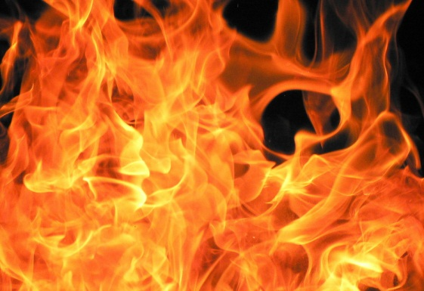
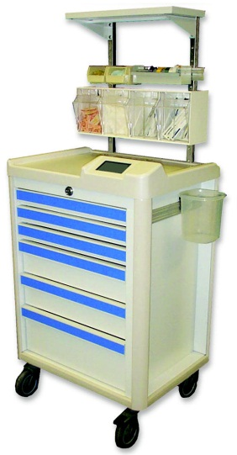
Examples of Emergency Codes
Code Red – Fire
Mr. Strongarm – Restraint help
Code Blue – Cardiac Arrest

Slide 3
Emergency Preparedness
Healthcare facilities have plans for handling emergencies.
Emergency codes may be paged over the facility paging system to alert associates to a situation where a response may be needed.
Students are not primary responders to emergencies but may be asked to assist as needed.
Your clinical instructor should make arrangements for you to learn the specifics of your facilities’ plans and processes.

Slide 4
Hazard Communication
Healthcare facilities use many substances which have the potential to be hazardous to associates and students.
To comply with federal OSHA (Occupational Safety and Health Administration) guidelines the facility MUST provide information about all potentially hazardous substances to those who use them during their work duties.

Slide 5
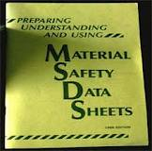
MSDS (Material Date Safety Sheets) describing these substances are available in each facility department in a binder and may be available on the facilities computer system as well.
Associates/ students are responsible to read the brochure to know about the chemicals they are exposed to in the course of their work.

Slide 6
Electrical Safety
Using electrical power carelessly could cause fire, shock, or explosion.
Electricity flows easily through conductors like copper, aluminum, other metals, water and the human body.
Insulation is high resistant to electrical flow. Good insulators are rubber, plastic, glass and dry wood.

Slide 7
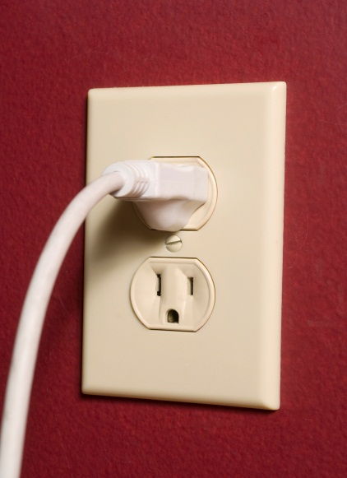
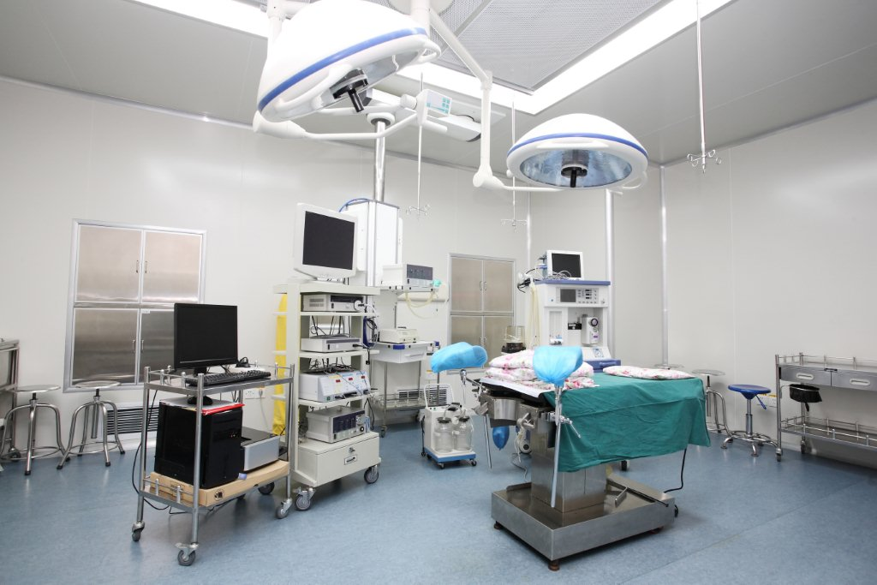
Healthcare facilities use multiple types of electrical equipment to care for patients.
Patients, families and others in the area must be protected from electrical current

Slide 8
In most electrical systems a current that leaks out of the system due to faulty wiring or some other defect is sent into the earth to be harmlessly discharged. This is called GROUNDING.
In such a system if a person touches a live wire the current will flow through him/ her to the ground – they become part of the electrical circuit.

Slide 9
A shock is particularly dangerous when it passes through vital organs like the heart and lungs.
Electrical hazards are not limited to shock, fires can result from overheating equipment or by conductors carrying too much current.
Burns from electrical accidents generate heat that can burn tissue deep inside the body.

Slide 10
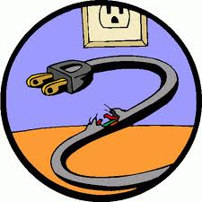
Preventing Electrical Accidents
Go on cord and plug patrol
Replace cords and plugs that appear damaged
or heat up when used.
Replace cords with insulation that cracked, torn or rubber off.
Do not use extension cords or adaptors
Do not run cords through doors, windows or around corners

Slide 11
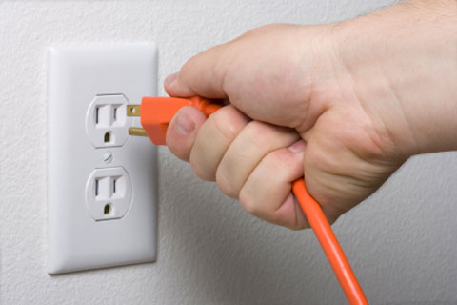
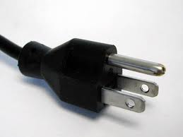
To remove a plug from an outlet – pull the PLUG not the cord.
Never bend off or bend the third prong on a grounded plug.

Slide 12
Protect Patients and Staff
When it comes to patient care, electric powered equipment is everywhere. Safety precautions must be just as prevalent.
Check all equipment prior to use.
In the event of a power outage, utilize “red plugs” which are powered by a generator for emergency equipment. Only essential equipment should be plugged into red plugs.
Most facilities have a “lock out, tag out” policy related to malfunctioning equipment. Take the equipment off the floor, report the problem to maintenance or biomedical, and tag the equipment “ broken/don’t use” per facility policy.

Slide 13
Know the hazards of the job
Don’t work near electrical equipment or outlets when hands, counters, floors or equipment are wet.
Do not use any electrical equipment that appears to be in damaged condition.
Disconnect all equipment from the power source before cleaning it.
Make sure all equipment is properly grounded or double insulated.

Slide 14
Electrical Emergencies
To remove someone from a live current – Do not touch the victim or source of current.
Disconnect equipment by pulling the plug or turning off the wall switch.
Call a qualified person to turn off the power at the main service panel.
If the victim is unconscious or burned, call for help immediately.
Check for respirations and pulse and start CPR if none are found.

Slide 15
Remember – prevention ALWAYS beats responding to an electrical emergency!!
Electrical malfunctions are the number one cause of fires in hospitals and healthcare facilities.
ANY electrical shock to an associate or student should be reported to employee health for medical follow up.

Slide 16
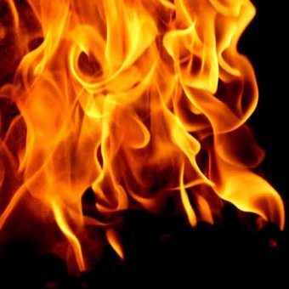
Fire Safety
Fires in a healthcare setting can be deadly.
Electrical fires are a high risk area in facilities.
Improper use and storage of hazardous materials may also cause fires.
Smoking is also a cause of fires in facilities.

Slide 17
R. A. C . E.
A Common acronym to identify actions which must be taken when a fire is identified is “R.A.C.E.”
R- Rescue the patient
A- Activate the alarm
C- Contain the fire
E- Extinguish / Evacuate (only when required)

Slide 18
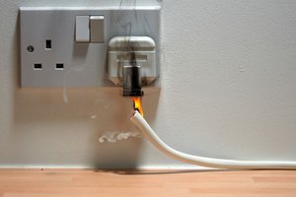
Associates and students
must be ever vigilant to
any source of fires in
health care facilities.
If a fire is noticed the first response must be to protect the patient and family from harm.

Slide 19
Rescue means remove patients from immediate fire site only.
Activate the fire alarm to call for additional assistance.
Contain the fire by closing the door to the fire area after removing patients.
Evacuate only upon the request of the supervisor or fire department.

Slide 20
Using a Fire Extinguisher
PASS is another acronym that reminds the fire extinguisher user to do the following:
Pull the lock pin from its place;
Aim the nozzle at the base of the flames;
Squeeze the handles together; and
Sweep from side to side at the base of the flames.

Slide 21
General Student Safety Information
Either a school issued or facility issued ID badge must worn in a visible location at all times while in the facility.
Healthcare facilities are smoke free facilities. Students may not smoke on any healthcare campus property. This may include in vehicles in the parking lot.

Slide 22
EMTALA
Federal Emergency Medical Treatment and Labor Act, also known as COBRA or the Patient Anti-Dumping Law. EMTALA requires most hospitals to provide an examination and needed stabilizing treatment, without consideration of insurance coverage or ability to pay, when a patient presents to an emergency room for attention to an emergency medical condition

Slide 23
Patient Safety
Medical errors can be reduced by always checking patient identification prior to medicating or preforming any intervention on a patient.
In the event a patient loses their ID bracelet, follow facility policy for replacing ASAP
Risk factors in patient falls: not waiting for assist to use bathroom, impaired balance or gait, altered mobility, impaired cognition, visual impairment, and use of certain medications.
Notes:
Code Pink-is abduction of an infant. Exits are manned to intervene on someone leaving the building with the baby
Bomb threat-get as much information as possible if someone calls in bomb threat,notify security,police
Internal disaster vs. external disaster – bomb vs. school shooting or bus accident. Tornado watch vs. warning

Slide 24
Abuse and Neglect
Under Colorado Revised Statutes §19-3-304 doctors, school personnel, social workers, mental health workers, and clergy members are required by law to report possible child abuse. The State of Colorado also provides protection for adults considered at risk (Federal Law 1974 Child Abuse Prevention and Treatment Act).

